Slide 1
RTGI using rasterization
Che Sun

Slide 2
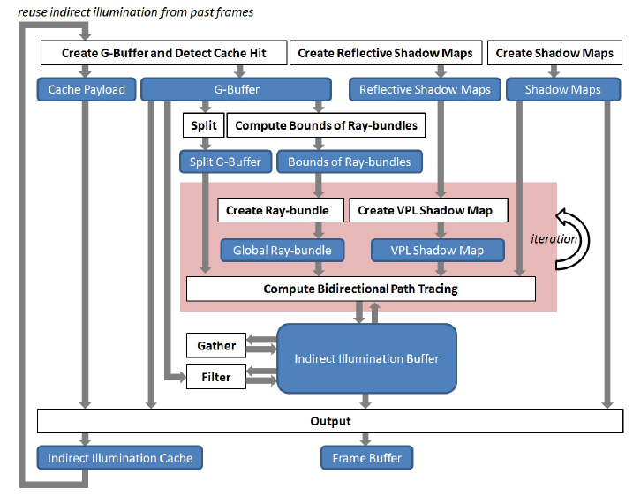
System Architecture

Slide 3
Hierarchical View of Technique Dependencies
RTGI using Rasterization
Sampling and Reconstruction
Indirect Illumination
Direct Illumination
Interleaved Sampling
Frame Coherence Cache
Bidirectional Path Tracing
Direct Shadow using Rasterization (Regular Shadow Maps)
Direct Lighting Deferred Shading
G-Buffer Split
Instant Radiosity using Rasterization
Global Ray-bundles using Rasterization
Cubemap Shadow Maps
G-Buffer Creation
Scene Light RSMs Creation
Ray-bundles BV Computation using Compute Shader
GPU Concurrent Linked List
Indirect Illumination Buffer Creation and Filtering
Splatting Indirect Illumination (VPL Creation)
Shader Atomic Operations
Shader Storage Buffer
VPL Shadow Maps (Paraboloid Mapping)
Imperfect Shadow Maps
Scene Geometry Tesselation

